Slide 1


.Net Architecture

Slide 2
What is the .NET Framework?
The .NET Framework is a new and revolutionary platform created by Microsoft for developing applications
It is a platform for application developers
It is a Framework that supports Multiple Language and Cross language integration.
IT has IDE (Integrated Development Environment).
Framework is a set of utilities or can say building blocks of your application system.
.NET Framework provides GUI in a GUI manner.

Slide 3
What is the .NET Framework?
.NET is a platform independent but with help of Mono Compilation System (MCS). MCS is a middle level interface.
.NET Framework provides interoperability between languages i.e. Common Type System (CTS) .
.NET Framework also includes the .NET Common Language Runtime (CLR), which is responsible for maintaining the execution of all applications developed using the .NET library.
The .NET Framework consists primarily of a gigantic library of code.
Definition: A programming infrastructure created by Microsoft for building, deploying, and running applications and services that use .NET technologies, such as desktop applications and Web services.

Slide 4
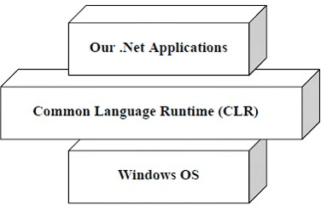
.Net Architecture and .Net Framework basics

Slide 5
.Net Architecture and .Net Framework basics
Common Language Runtime (CLR) The heart of the .Net Framework. It is also called the .Net runtime. It resides above the operating system and handles all .Net applications. It handles garbage collection, Code Access Security (CAS) etc.
Microsoft Intermediate Language (MSIL) Code When we compile our .Net code then it is not directly converted to native/binary code; it is first converted into intermediate code known as MSIL code which is then interpreted by the CLR. MSIL is independent of hardware and the operating system. Cross language relationships are possible since MSIL is the same for all .Net languages. MSIL is further converted into native code.

Slide 6
.Net Architecture and .Net Framework basics
Just in Time Compilers (JIT) It compiles IL code into native executable code (exe or dlls). Once code is converted to IL then it can be called again by JIT instead of recompiling that code.
Framework class library The .Net Framework provides a huge class library called FCL for common tasks. It contains thousands of classes to access Windows APIs and common functions like string manipulations, Data structures, stream, IO, thread, security etc.

Slide 7
.Net Architecture and .Net Framework basics
Common Language Specification (CLS) What makes a language to be .Net compliant? Answer is CLS. Microsoft has defined some specifications that each .Net language has to follow. For e.g.: no pointer, no multiple inheritances etc.
Common Type System (CTS) CTS defines some basic data types that IL can understand. Each .Net compliant language should map its data types to these standard data types. This makes it possible for two .Net compliant languages to communicate by ing/receiving parameters to and from each other. For example CTS defines Int32 for C# int and VB integer data types.

Slide 8
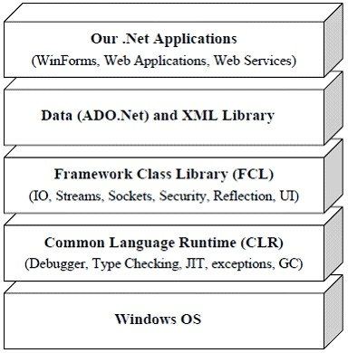
.Net Architecture and .Net Framework basics
The .Net Framework Is a combination of CLR, FCL, ADO.Net and XML classes, Web/Window applications and Web services.

Slide 9
Thank You

